Slide 1

REAL-TIME LOGO DETECTION USING YOLOV5

Slide 2


INTRODUCTION
IKHBAR FIRMAN
FAISAL KENGO
Built model
Managed model deployment
Dataset analysis
Model analysis
github.com/ikhbarfirman
github.com/faisalkengo

Slide 3
BACKGROUND
Companies pay astonishing amounts of money to sponsor events and raise brand visibility. Event sponsoring and social media is a well-established marketing strategy to build brand awareness.
There are 72% of consumers positively view brands that provide them with positive experiences, such as a great sports game or music festival. (eventmarketer.com study)
According to Harvard researchers, about 90% of purchasing decisions are subconscious. So, the higher is brand visibility for communities on the web, the more impact a brand has on consumer buying activity.
Chevrolet pays $71.4 million dollars each year to put its brand on Manchester United shirts. (brandwatch)
The logo detection technology allows scanning images and real-time video streams for logos to get real uses of products by customers, facilitate monitoring the ROI of marketing campaigns, ensure revenue boost, and more.

Slide 4
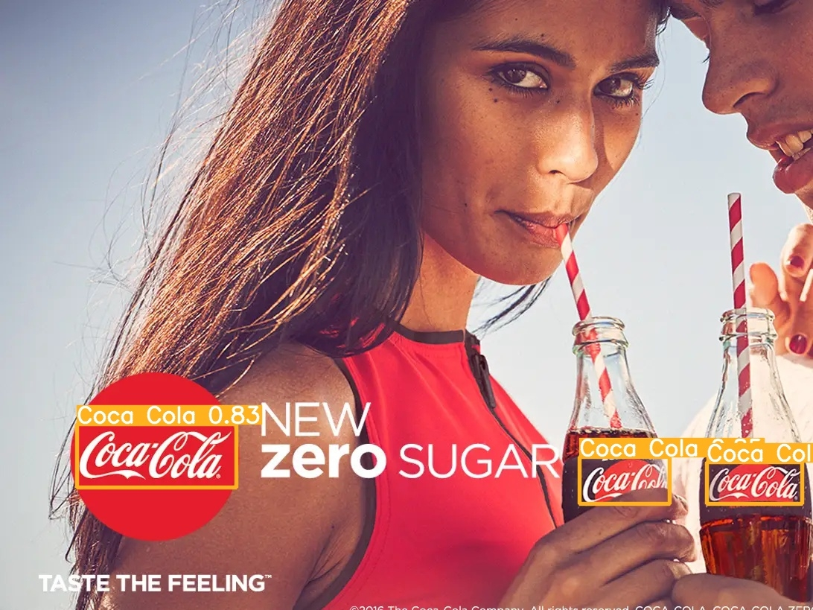
WHY detect logo??
Accurate logo recognition in images can have multiple applications.
Digital piracy monitoring
Ad monitoring platforms
Copyright & trademark compliance
Sponsorship monitoring
Notes:
Gambar di slide ini merupakan hasil coca cola logo detection dari model kami

Slide 5
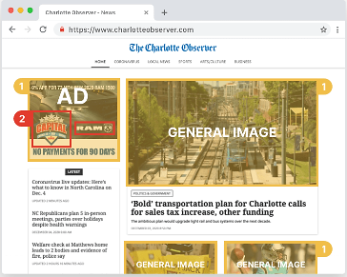
Ad Monitoring
Object detection
Identification of ADs vs. general imagery
Logo detection
“Capital Chrysler” assigned AD ownership
visua.com/use-case/ad-monitoring-intelligence-with-visual-ai

Slide 6
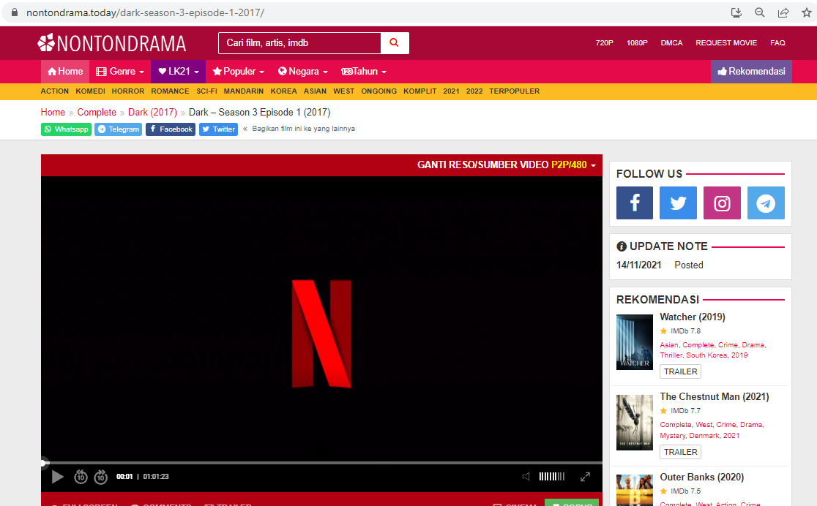
Digital Piracy Monitoring
Netflix videos found on nonton*****.today
Logo detection
Netflix logo detected in video

Slide 7
TABLE OF CONTENTS
 | 21/9 | 22/9 | 23/9 | 24/9 | 25/9 | 26/9 | 27/9 | 28/9 | 29/9
Idea & Dataset Brainstorming
Idea & Model Finalization
Exploring the Dataset
YOLOv5 Model Training & Deployment Attempt
YOLOv5 Model Development & User Manual Creation
Slides & Demo Video Creation
Model Analysis
Final Check-up

Slide 8

COCA – COLA Logo detection on event: “Taste The Feeling Festival”
(February 2016, Manila, Philippines)
Source: youtube.com/watch?v=JrWEyP6nlOY
Notes:
Berikut ini adalah contoh output coca cola detection logo dari video coca cola event

Slide 9
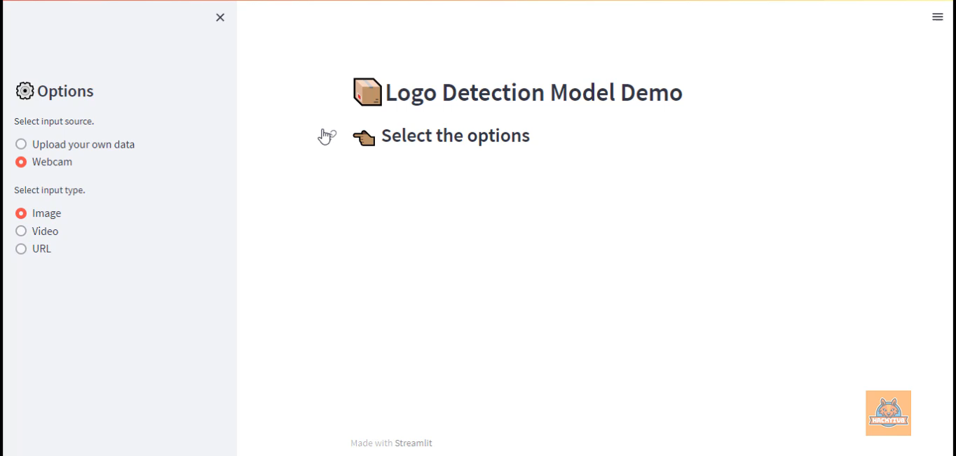
DEMO PROGRAM

Slide 10
OBSTACLES
CHALLENGE
LIMITATION
We had to work backwards for the project
First time implementation of YOLOv5 algorithm
Unexpectedly long model training duration
Heroku's free plan can't afford to deploy YOLOv5 model
Dataset used for training have logo from multiple type of product

Slide 11
SUCCESS STORY
SUCCESSFUL TRAIN
GREAT RESULT
Even though the model training took a long time to finish, we successfully implements the YOLOv5 algorithm
The trained model produced a 98% average precision rate during identifying process

Slide 12
STRETCH GOAL
DEPLOYMENT
MORE DATA
Deploy the model to a subscription hosting server to be used online
Getting a more specified logo sets for training
PHONE APP
VARIATION
Create phone application to run the model
Train the model for more kinds of brand logo

Slide 13
09/22
THANK YOU!

